Slide 1
5CO03 – Professional behaviours and valuing people
Tutor Support Session

Slide 2
Objectives of the session
1
Understand the content of the unit
2
Explore the key topics associated with the unit
3
Link the content to your assessment

Slide 3

What will I gain from this unit?
This unit focuses on how applying core professional behaviours such as ethical practice, courage and inclusivity can build positive working relationships and support employee voice and well-being. It considers how developing and mastering new professional behaviours and practice can impact performance

Slide 4
5CO03 - Task 1
Professional, ethical, and inclusive behaviours

Slide 5

Professional

Slide 6
Question What does the term 'professional' mean to you?

Slide 7
Professional
Possess required skills and knowledge to perform in their profession.
Are subject to a strict codes of conduct.
The standards of the profession are typically agreed upon and maintained through professional associations, such as the CIPD.
Elements of a People Professional
Body of expert knowledge and skills
Social and ethical responsibility
Situational judgement
CPD
CIPD's Professional Values
Principles led
Evidence based
Outcomes Driven

Slide 8
Question Why is it important we behave in a professional way?

Slide 9

CPD & Reflection
“Commitment to continued learning and development is a core element of professionalism and is, therefore, critical for all people professionals”.
- CIPD Profession Map – Passion for learning

Slide 10
Stages of the CPD cycle
Identify: Understand where you've come from, where you are and where you want to be.
Plan: Figure out how you can get to where you want to be. Establish clear outcomes and milestones for tracking progress.
Act: Utilise your plan, and be open to learning experiences.
Reflect: Make the most of your day-to-day learning by routinely reflecting upon experiences.
Apply: Create opportunities where you can translate theory into practice and put your learning to work.
Share: Share your learning in communities of practice, to generate greater insight and benefit from the support of your community.
Impact: Measure the overall impact your learning has had on the work you do.
https://www.cipd.co.uk/learn/cpd/cycle#gref

Slide 11

Personal Values

Slide 12
Personal Values
Values
A person's principles or standards of behaviour; one's judgment of what is important in life.
My Values
I personally value - transparency, honesty, and fairness. I try to be as open and honest as possible in my communications and in how I deal with others. It's important for me to know the truth so I can understand situations and the reasons behind them. If I see people who are treated less fairly than others it demotivates and impacts my work and the relationships with others as it diminishes trust.

Slide 13

Ethics

Slide 14
Ethical practice
Ethical practice is the application of ethical values in organisational behaviour.
It applies in all aspects of organisational conduct, including corporate governance, employment practices, sales techniques, stakeholder relations, accounting practices, and issues of product and corporate responsibility.
It’s about the discretionary decisions that organisations and the people who work for them make, and how transparent the relevant stakeholders are about those decisions.
Are colleagues treated with dignity and respect?
Are customers treated fairly?
Does the organisation acknowledge its responsibilities to wider society?
https://www.cipd.co.uk/knowledge/culture/ethics/role-hr-factsheet

Slide 15
QUESTION Do your values match with your workplace ethics?

Slide 16
Influence

Slide 17
French and Ravens Sources of Power
Legitimate -The formal right to make demands.
Reward - To compensate another for compliance.
Expert - Based on a person's high levels of skill and knowledge.
Referent - Respected by others.
Coercive -A person can punish others for noncompliance.
Informational - Ability to control the information.
(Mindtools, 2021)
https://www.mindtools.com/pages/article/newLDR_56.htm

Slide 18

Included, valued and fairly treated

Slide 19
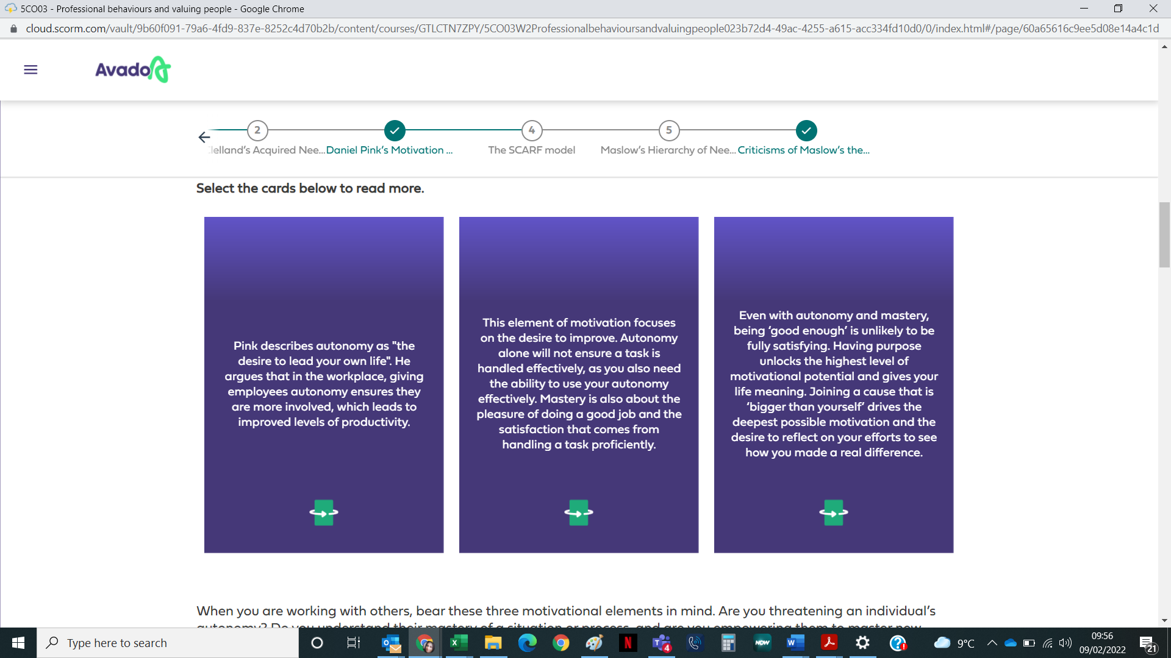
Daniel Pink's Motivation Theory
Autonomy
Mastery
Purpose

Slide 20
QUESTION What can we do to promote autonomy, mastery and purpose?

Slide 21
Arguments for being included, valued and fairly treated
By sharing the purpose of the organisation and showing how our employees fit into the bigger picture and help the organisation to achieve it then they are more likely to feel valued and included.
If our employees have a degree of autonomy of the way their work is done then they will feel valued, and included by the organisation. If employees feel included in this wider purpose and see how they fit in, it will be rewarding and empowering.
Benefits:
Increased job satisfaction
Enhanced Corporate reputation
Increased worker well-being
Increased retention and reduced turnover rates

Slide 22
Further arguments with relevant for sources
IPD’s report 'Diversity and Inclusion at Work – Facing Up to the Business Case' highlights that feelings of inclusion are linked to greater commitment and lower absenteeism. Inclusion encourages a healthy, collaborative climate for employees. https://www.cipd.co.uk/knowledge/fundamentals/relations/diversity/diversity-inclusion-report#gref
Furthermore, as CIPD Research Advisor Jake Young reports in a 2019 article for businessandindustry.co.uk, an inclusive environment has strong links with innovation, creativity, and wider knowledge sharing within and between teams. https://www.businessandindustry.co.uk/diversity-and-inclusion/empowering-employees-to-champion-inclusion-at-work/#

Slide 23
Break out room activity People practice initiatives –

Slide 24
PP problem: Low engagement scores leading to high levels of employee turnover. Task: How do you find out need for an intervention? How do you involve stakeholders when designing the solution? How do you evaluate the success of the intervention. ?

Slide 25
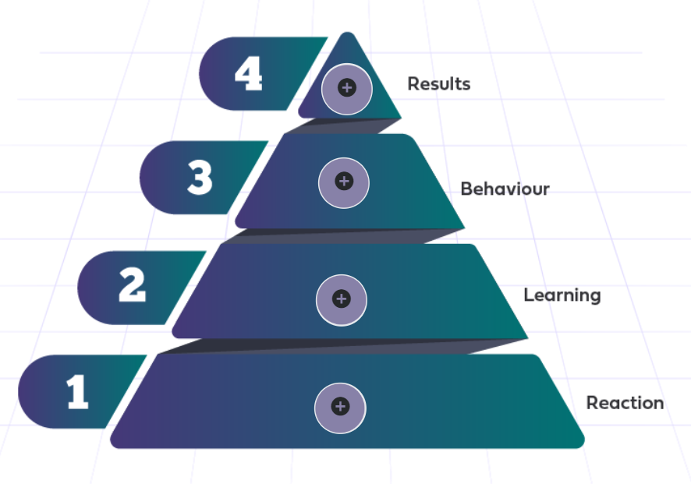
Kirkpatrick’s four-level training evaluation method
This is a popular model for analysing and evaluating the results of training and educational programmes. It seeks to determine effectiveness by working through four evaluation levels.

Slide 26
5CO03 - Task 2
Professional Development

Slide 27
Specialist expertise and future work skills
As a people practitioner, your skills will adapt and evolve as time goes on, depending on the areas of the business you are exposed to.
Many people join organisations as a ‘HR Generalist’, only to acquire specialist knowledge and go down a career path in areas like learning and development (L&D) or organisation design and development (OD&D).

Slide 28
Specialist expertise and future work skills
The CIPD lists nine areas of specialist knowledge in the Profession Map:
Employee experience
Employee relations
Diversity and inclusion
Learning and development
Organisation development and design
People analytics
Resourcing
Reward
Talent management
How is your role evolving?

Slide 29
Self-assessment

Slide 30
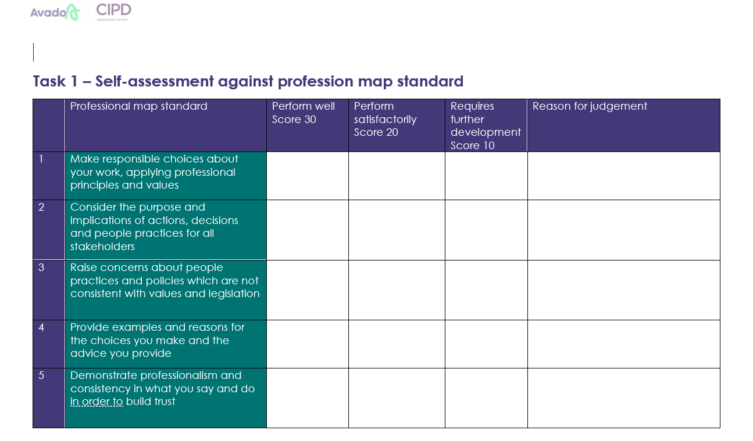

Slide 31
Personal development plan

Slide 32
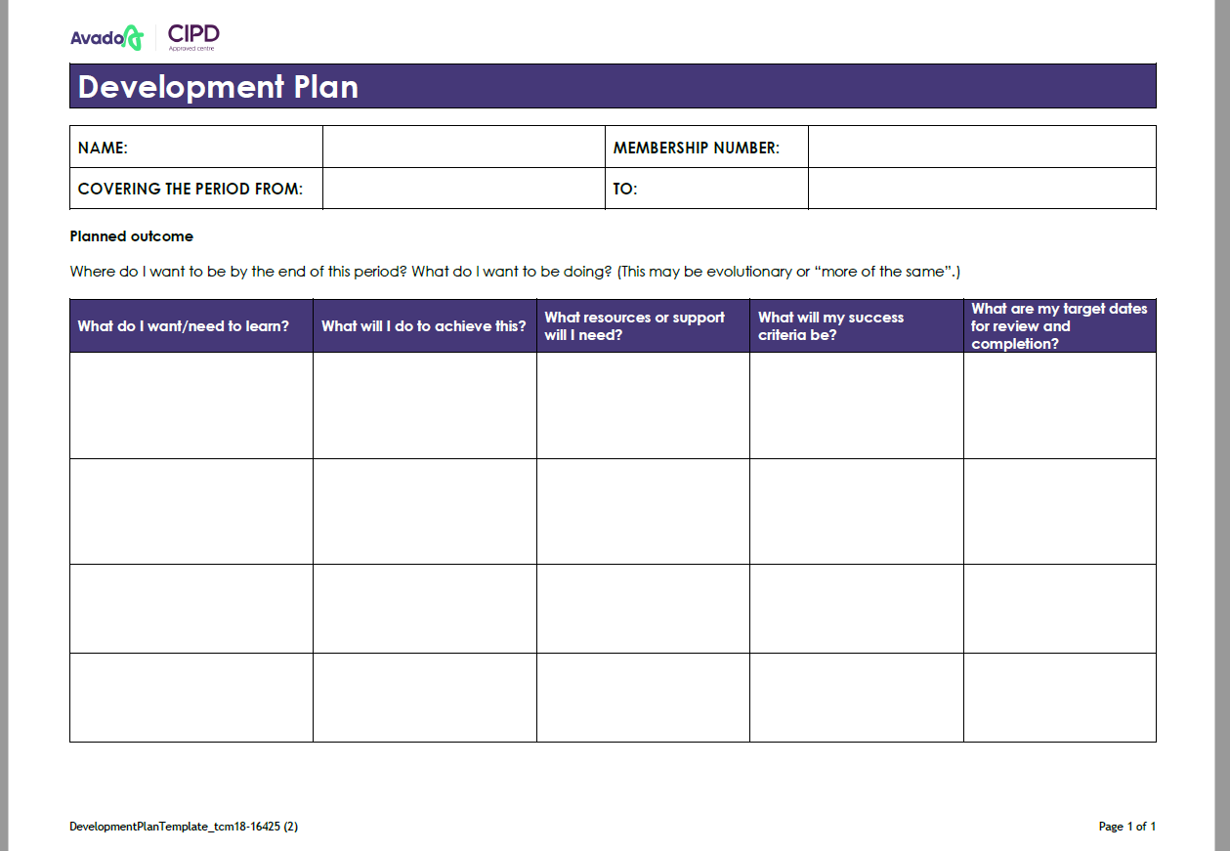

Slide 33
Task 1 – Written responses
In this this task, you are required to demonstrate a professional level of knowledge and
understanding in relation to ‘professional, ethical and inclusive behaviours’.
To complete the task, you should provide a written response to each of the points, making appropriate use of academic theory and practical examples to expand your response and illustrate key points.
To help the reader, please make use of headings and assessment criteria references to signpost
the assessment criteria being addressed.
Hints and Tips:
Review the guidance on the assessment brief and grading grid
Your responses should be 2100 +/- 10%. Refer to the CIPD word count policy for more information.

Slide 34
Task 2 – CPD
This task requires you to evidence your commitment and approach to continuing professional development (CPD). It is divided into three activities, which must all be completed.
There are 2 different options for how you complete the 3 activities: these are
The CIPD Profession Map Self-Assessment Tool,
Offline documentation.
Produce a CPD portfolio including:
Activity 1:
In the main body of your assignment, write a short summary (approx. 150 words), of the information used to inform your assessment
Add your assessment pages as an appendix.
Activity 2:
In the main body of your assignment, write a short explanation (approx. 250 words) for your choice of development activities
Add the relevant pages from your development/learning plan as an appendix
Activity 3:
Written reflections on 3 development activities (approx. 750 words)
*please ensure you refer to the grading grid and assessment brief for further guidance and information*

Slide 35
5CO03 – Important information
Wordcount:
Task 1: 2,100 +/- 10% words.
Task 2: 1150 +/- 10% words.
Submission file: (name your files as follows)
Task 1: 5CO03_Task1_[your name] Task 2: 5CO03_Task 2_[your name]

Slide 36
Resources
https://icrrd.com/media/01-11-2020-204705The%20Self%20Confidence%20Workbook.pdf
https://www.cipd.co.uk/knowledge/culture/ethics/role-hr-factsheet
https://www.cipd.co.uk/knowledge/fundamentals/relations/diversity/diversity-inclusion-report#gref
https://www.businessandindustry.co.uk/diversity-and-inclusion/empowering-employees-to-champion-inclusion-at-work/#
https://www.cipd.co.uk/learn/cpd/cycle#gref

Slide 37
Question time

